Slide 1
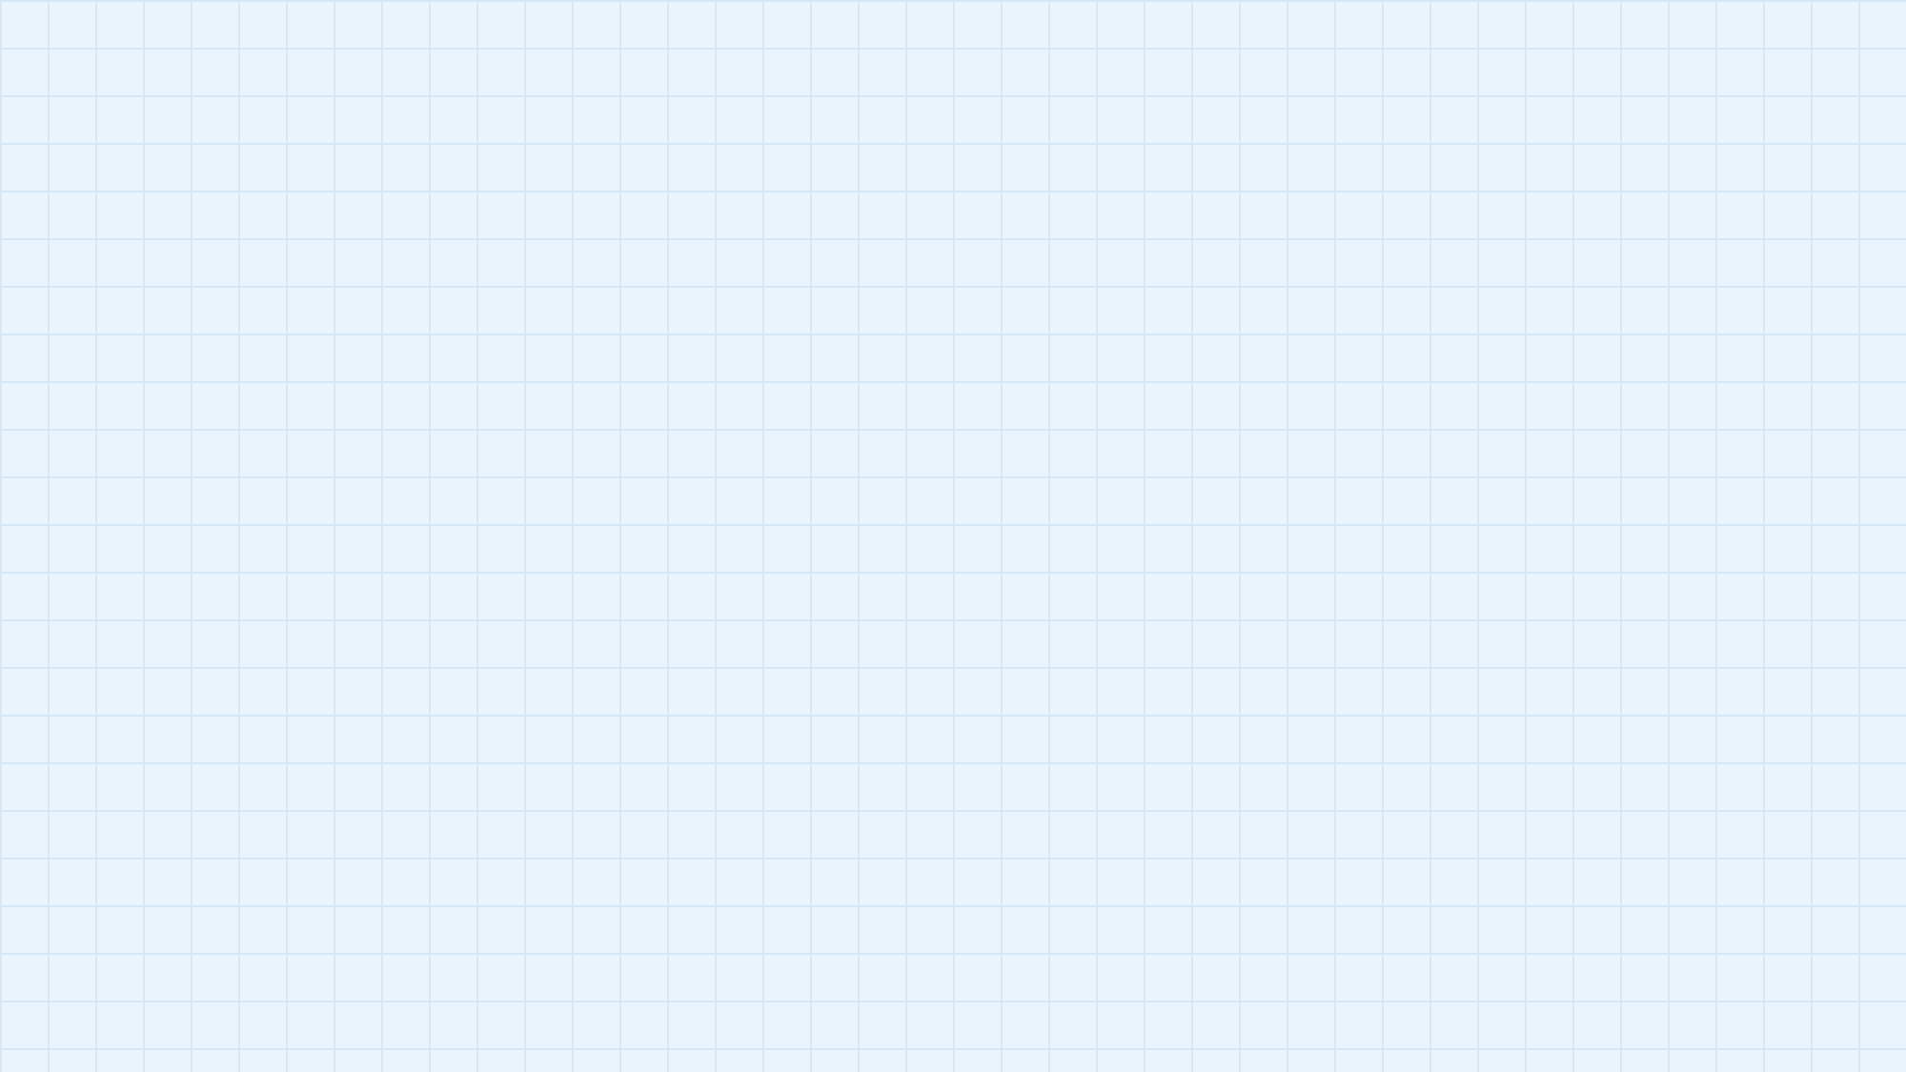
IMAGE CLASSIFICATION
USING CNN & YOLOv11
Training and comparing two deep learning approaches: a custom CNN and a pretrained YOLOv11 classifier.
Future work: transfer learning with MobileNetV2, ResNet50 and EfficientNetB0 on new Kaggle datasets.
Team presentation
Mohan Dev Roy
Samiun Mahamud
Susmit Talukder
Sudharshan Ghosh
Notes:
Introduce the project and the team.

Slide 2
TEAM CONTRIBUTIONS
MD
Mohan Dev Roy
SM
Samiun Mahamud
YOLO model training
CNN model training
ST
Susmit Talukder
SG
Sudharshan Ghosh
Dataset creation & preprocessing
YOLO dataset & preprocessing
Mohan Dev Roy
Samiun Mahamud
Susmit Talukder
Sudharshan Ghosh
Notes:
Each member owned one part of the pipeline.

Slide 3
DATASET CREATION & PREPROCESSING
Dataset Creation
Preprocessing Pipeline
Collected and organised images into class-wise folders
Class labels are read automatically from folder names
Kept classes balanced with equal samples per class
Checked and cleaned images before training
1 Load images
2 Resize to a fixed size
3 Normalize pixels 0–255 → 0–1
4 Split: train / validation / test
Mohan Dev Roy
Samiun Mahamud
Susmit Talukder
Sudharshan Ghosh
Notes:
Susmit built the dataset and prepared it for the CNN.

Slide 4
CNN MODEL TRAINING
Why CNN?
Model Structure
Effective for image feature extraction
Automatically learns edges, textures and shapes
Conv + Pooling layers
Flatten
Dense layers
Softmax output
→
→
→
Training Setup
Adam optimizer with a multi-class loss
Validation data used to monitor overfitting
Mohan Dev Roy
Samiun Mahamud
Susmit Talukder
Sudharshan Ghosh
Notes:
Samiun trained the custom CNN.

Slide 5
YOLO DATASET & PREPROCESSING
YOLO Classification Format
Preparation Steps
Folder name = class label
Images only, no annotation files
1 Unzip dataset (class folders)
2 Auto-split into train / val / test
dataset_yolo/
├── train/
├── val/
└── test/
3 Verify balanced classes
Mohan Dev Roy
Samiun Mahamud
Susmit Talukder
Sudharshan Ghosh
Notes:
Sudharshan converted the raw images into a YOLO-compatible classification dataset.

Slide 6
YOLOv11 MODEL TRAINING
Model Used
Training Workflow
YOLOv11 Nano classification variant
Lightweight and fast, suitable for real-time use
Pretrained on ImageNet (transfer learning)
Faster convergence with fewer epochs
1 Load pretrained weights
2 Train on the YOLO dataset
3 Validate each epoch
4 Save best weights
Mohan Dev Roy
Samiun Mahamud
Susmit Talukder
Sudharshan Ghosh
Notes:
Mohan trained the YOLOv11 classification model.

Slide 7
FUTURE PLAN
Collect different datasets from Kaggle and train these transfer learning models on them
MobileNetV2
ResNet50
EfficientNetB0
Lightweight, built for mobile and edge devices
Deep residual network with strong feature learning
Balances accuracy and efficiency through compound scaling
Mohan Dev Roy
Samiun Mahamud
Susmit Talukder
Sudharshan Ghosh
Notes:
Next we move to new Kaggle datasets and stronger pretrained backbones.

Slide 8
THANK YOU
Questions are welcome
Mohan Dev Roy
Samiun Mahamud
Susmit Talukder
Sudharshan Ghosh
Notes:
Thank the audience and take questions.

